Slide 1


Slide 2

Chapter 13
Disk Storage, Basic File Structures, and Hashing.
Copyright © 2004 Pearson Education, Inc.

Slide 3
Chapter Outline
Disk Storage Devices
Files of Records
Operations on Files
Unordered Files
Ordered Files
Hashed Files
  Dynamic and Extendible Hashing Techniques
RAID Technology

Slide 4
Disk Storage Devices (cont.)
Preferred secondary storage device for high storage capacity and low cost.
Data stored as magnetized areas on magnetic disk surfaces.
A disk pack contains several magnetic disks connected to a rotating spindle.
Disks are divided into concentric circular tracks on each disk surface. Track capacities vary typically from 4 to 50 Kbytes.

Slide 5
Disk Storage Devices (cont.)
Because a track usually contains a large amount of information, it is divided into smaller blocks or sectors.
The division of a track into sectors is hard-coded on the disk surface and cannot be changed. One type of sector organization calls a portion of a track that subtends a fixed angle at the center as a sector.
A track is divided into blocks. The block size B is fixed for each system. Typical block sizes range from B=512 bytes to B=4096 bytes. Whole blocks are transferred between disk and main memory for processing.

Slide 6
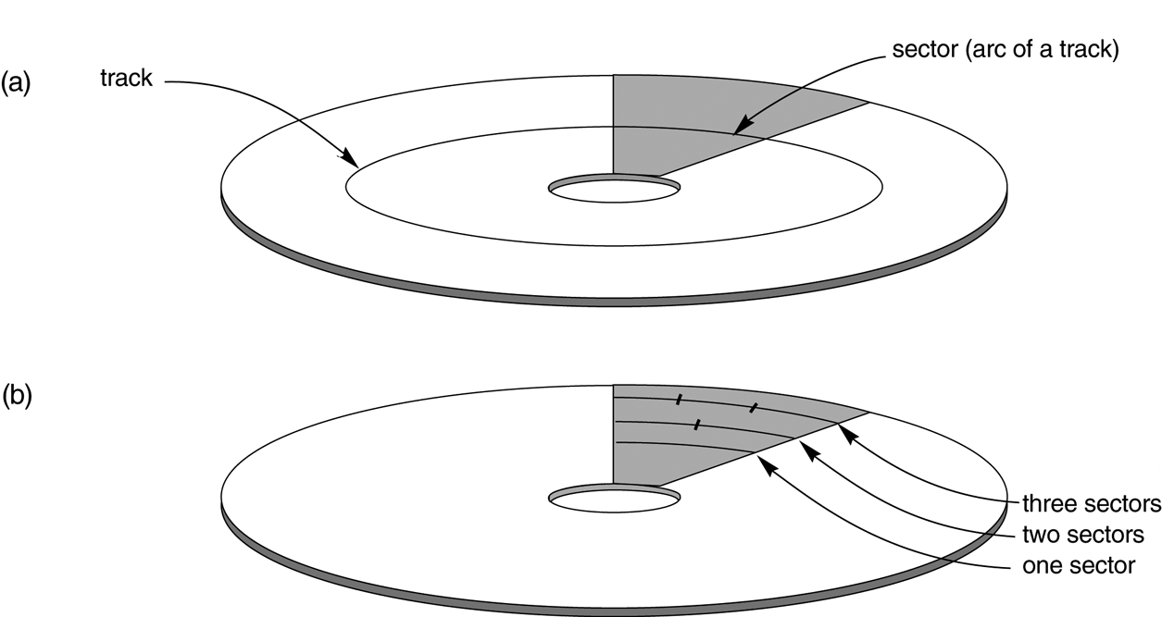
Disk Storage Devices (cont.)

Slide 7
Disk Storage Devices (cont.)
A read-write head moves to the track that contains the block to be transferred. Disk rotation moves the block under the read-write head for reading or writing.
A physical disk block (hardware) address consists of a cylinder number (imaginery collection of tracks of same radius from all recoreded surfaces), the track number or surface number (within the cylinder), and block number (within track).
Reading or writing a disk block is time consuming because of the seek time s and rotational delay (latency) rd.
Double buffering can be used to speed up the transfer of contiguous disk blocks.

Slide 8
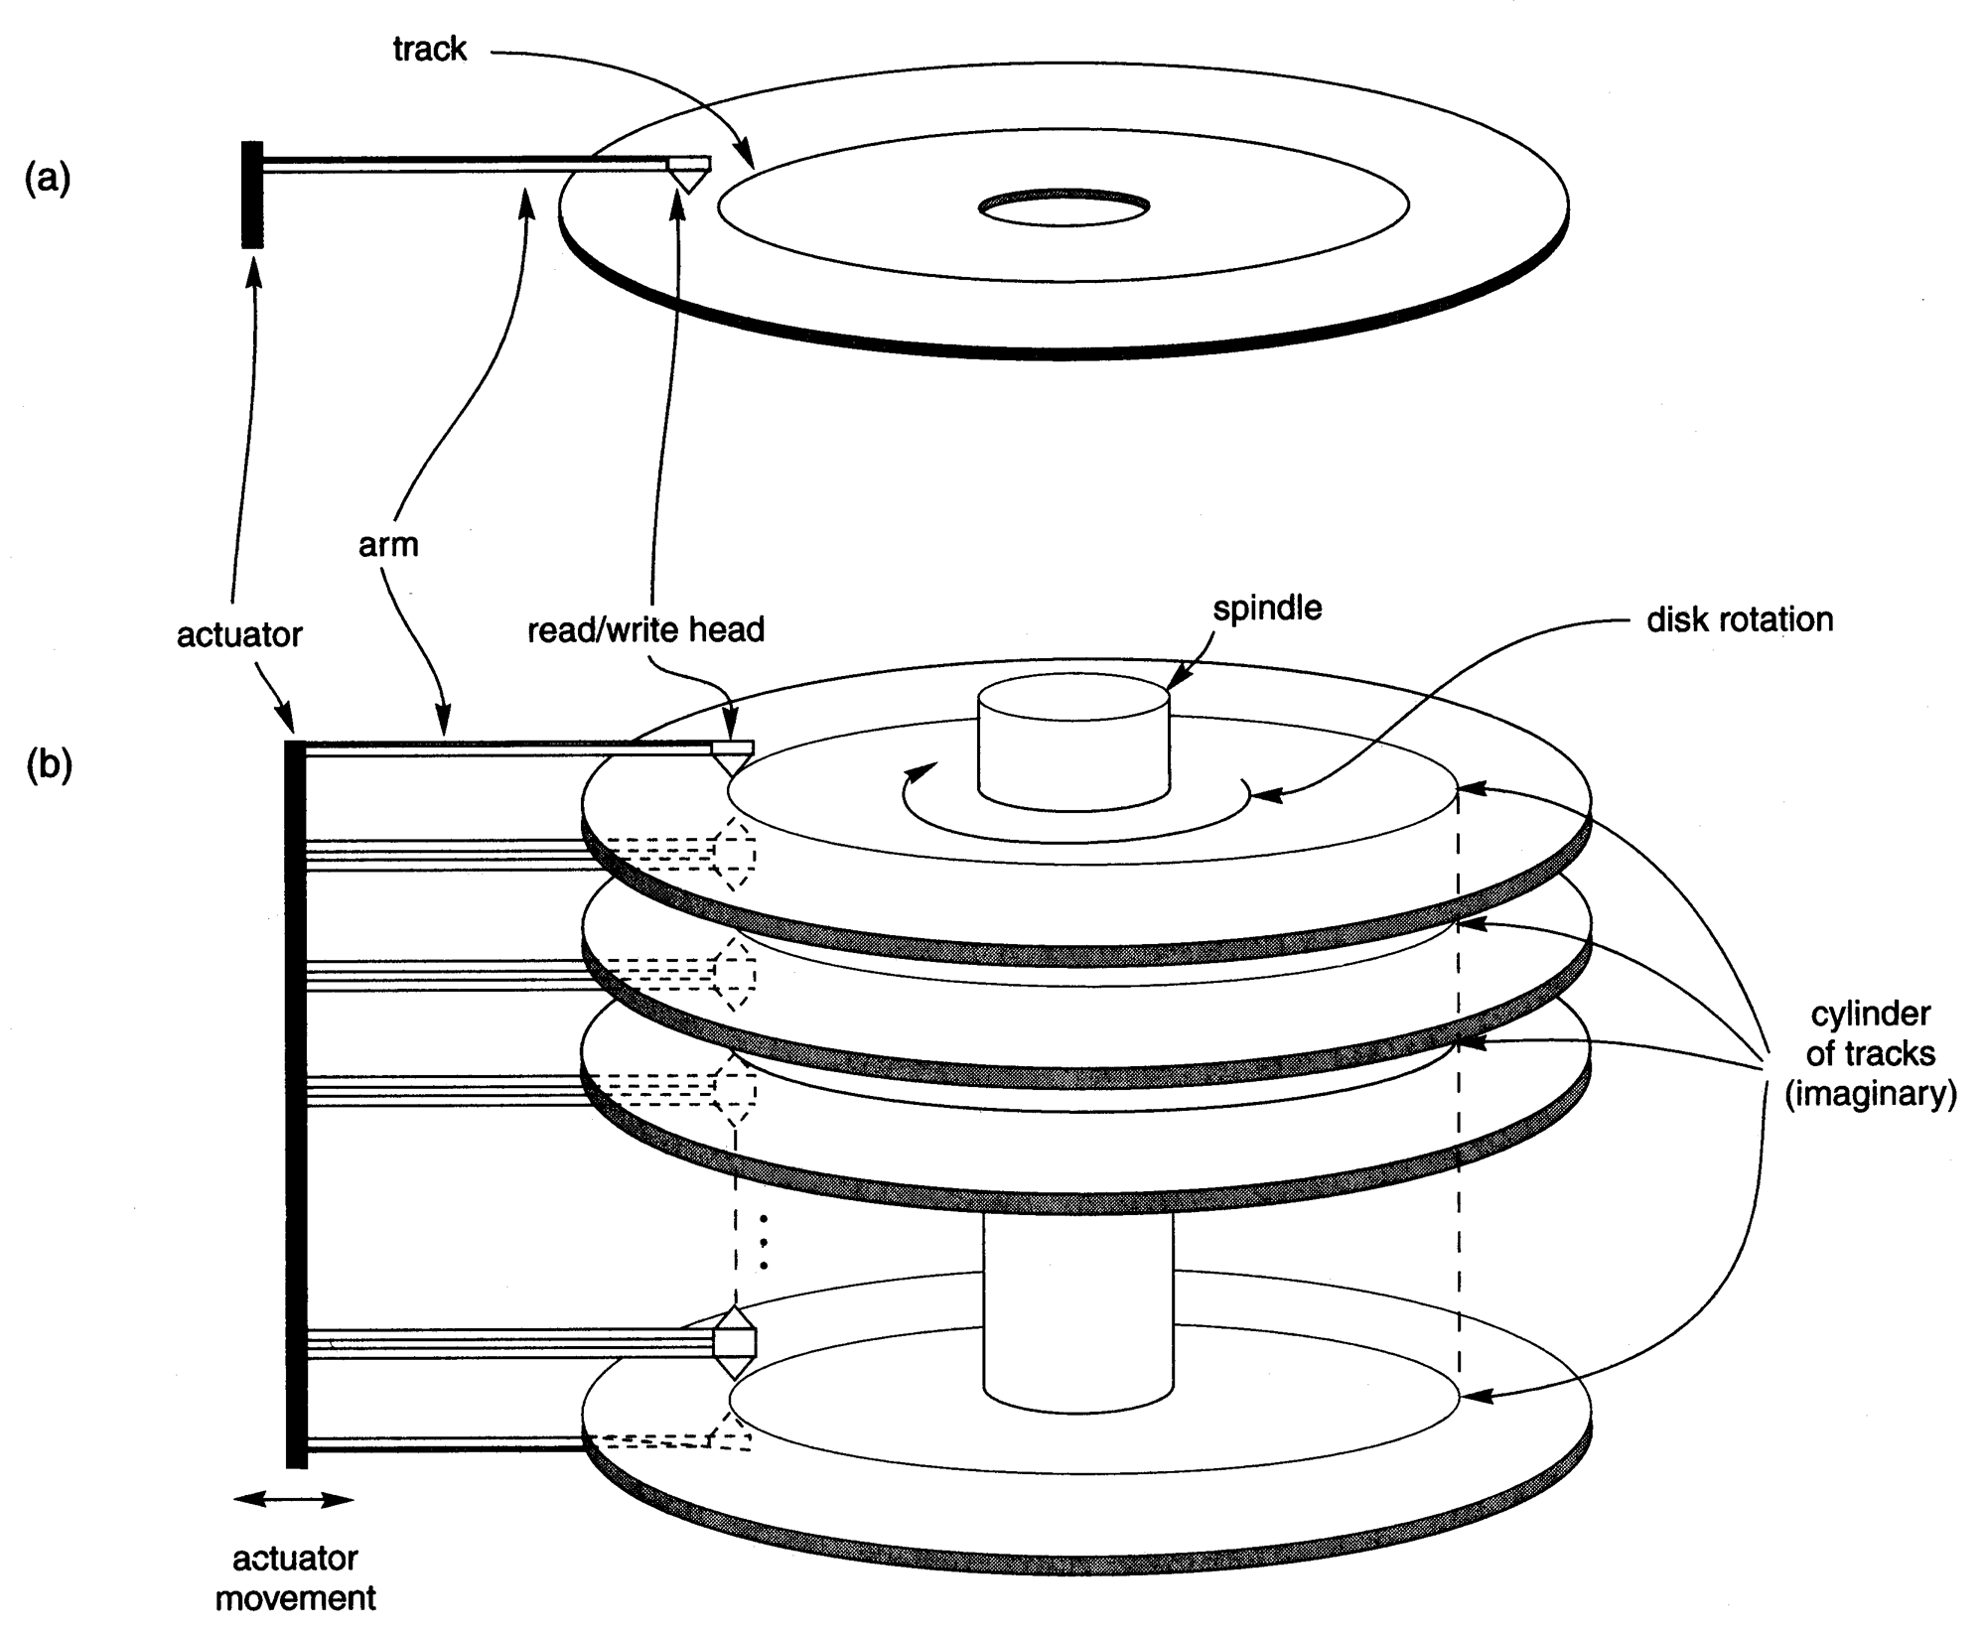
Disk Storage Devices (cont.)

Slide 9
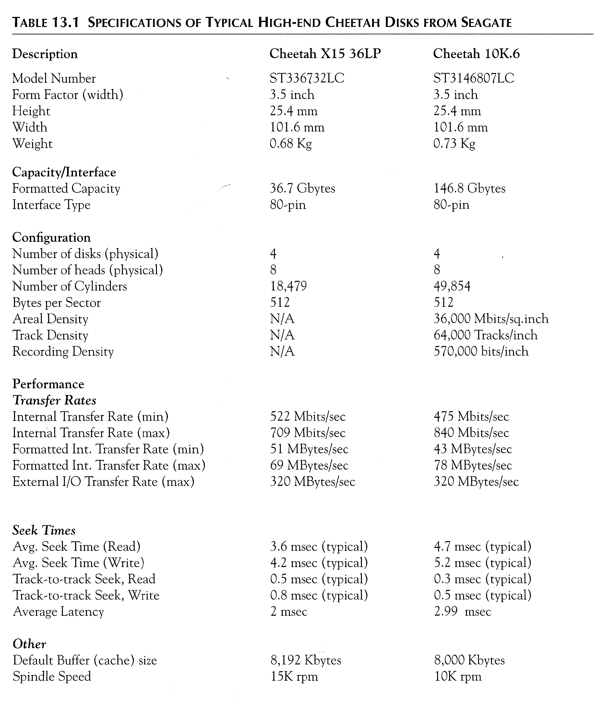
Typical Disk Parameters

Slide 10
Records
Fixed and variable length records
Records contain fields which have values of a particular type (e.g., amount, date, time, age)
Fields themselves may be fixed length or variable length
Variable length fields can be mixed into one record: separator characters or length fields are needed so that the record can be “parsed”.

Slide 11
Blocking
Blocking: refers to storing a number of records in one blo ck on the disk.
Blocking factor (bfr) refers to the number of records per block.
There may be empty space in a block if an integral number of records do not fit in one block.
Spanned Records: refer to records that exceed the size of one or more blocks and hence span a number of blocks.

Slide 12
Files of Records
A file is a sequence of records, where each record is a collection of data values (or data items).
A file descriptor (or file header ) includes information that describes the file, such as the field names and their data types, and the addresses of the file blocks on disk.
Records are stored on disk blocks. The blocking factor bfr for a file is the (average) number of file records stored in a disk block.
A file can have fixed-length records or variable-length records.

Slide 13
Files of Records (cont.)
File records can be unspanned (no record can span two blocks) or spanned (a record can be stored in more than one block).
The physical disk blocks that are allocated to hold the records of a file can be contiguous, linked, or indexed.
In a file of fixed-length records, all records have the same format. Usually, unspanned blocking is used with such files.
Files of variable-length records require additional information to be stored in each record, such as separator characters and field types. Usually spanned blocking is used with such files.

Slide 14
Operation on Files
Typical file operations include:
OPEN: Readies the file for access, and associates a pointer that will refer to a current file record at each point in time.
FIND: Searches for the first file record that satisfies a certain condition, and makes it the current file record.
FINDNEXT: Searches for the next file record (from the current record) that satisfies a certain condition, and makes it the current file record.
READ: Reads the current file record into a program variable.
INSERT: Inserts a new record into the file, and makes it the current file record.

Slide 15
Operation on Files (cont.)
DELETE: Removes the current file record from the file, usually by marking the record to indicate that it is no longer valid.
MODIFY: Changes the values of some fields of the current file record.
CLOSE: Terminates access to the file.
REORGANIZE: Reorganizes the file records. For example, the records marked deleted are physically removed from the file or a new organization of the file records is created.
READ_ORDERED: Read the file blocks in order of a specific field of the file.

Slide 16
Unordered Files
Also called a heap or a pile file.
New records are inserted at the end of the file.
To search for a record, a linear search through the file records is necessary. This requires reading and searching half the file blocks on the average, and is hence quite expensive.
Record insertion is quite efficient.
Reading the records in order of a particular field requires sorting the file records.

Slide 17
Ordered Files
Also called a sequential file.
File records are kept sorted by the values of an ordering field.
Insertion is expensive: records must be inserted in the correct order. It is common to keep a separate unordered overflow (or transaction ) file for new records to improve insertion efficiency; this is periodically merged with the main ordered file.
A binary search can be used to search for a record on its ordering field value. This requires reading and searching log₂ of the file blocks on the average, an improvement over linear search.
Reading the records in order of the ordering field is quite efficient.

Slide 18
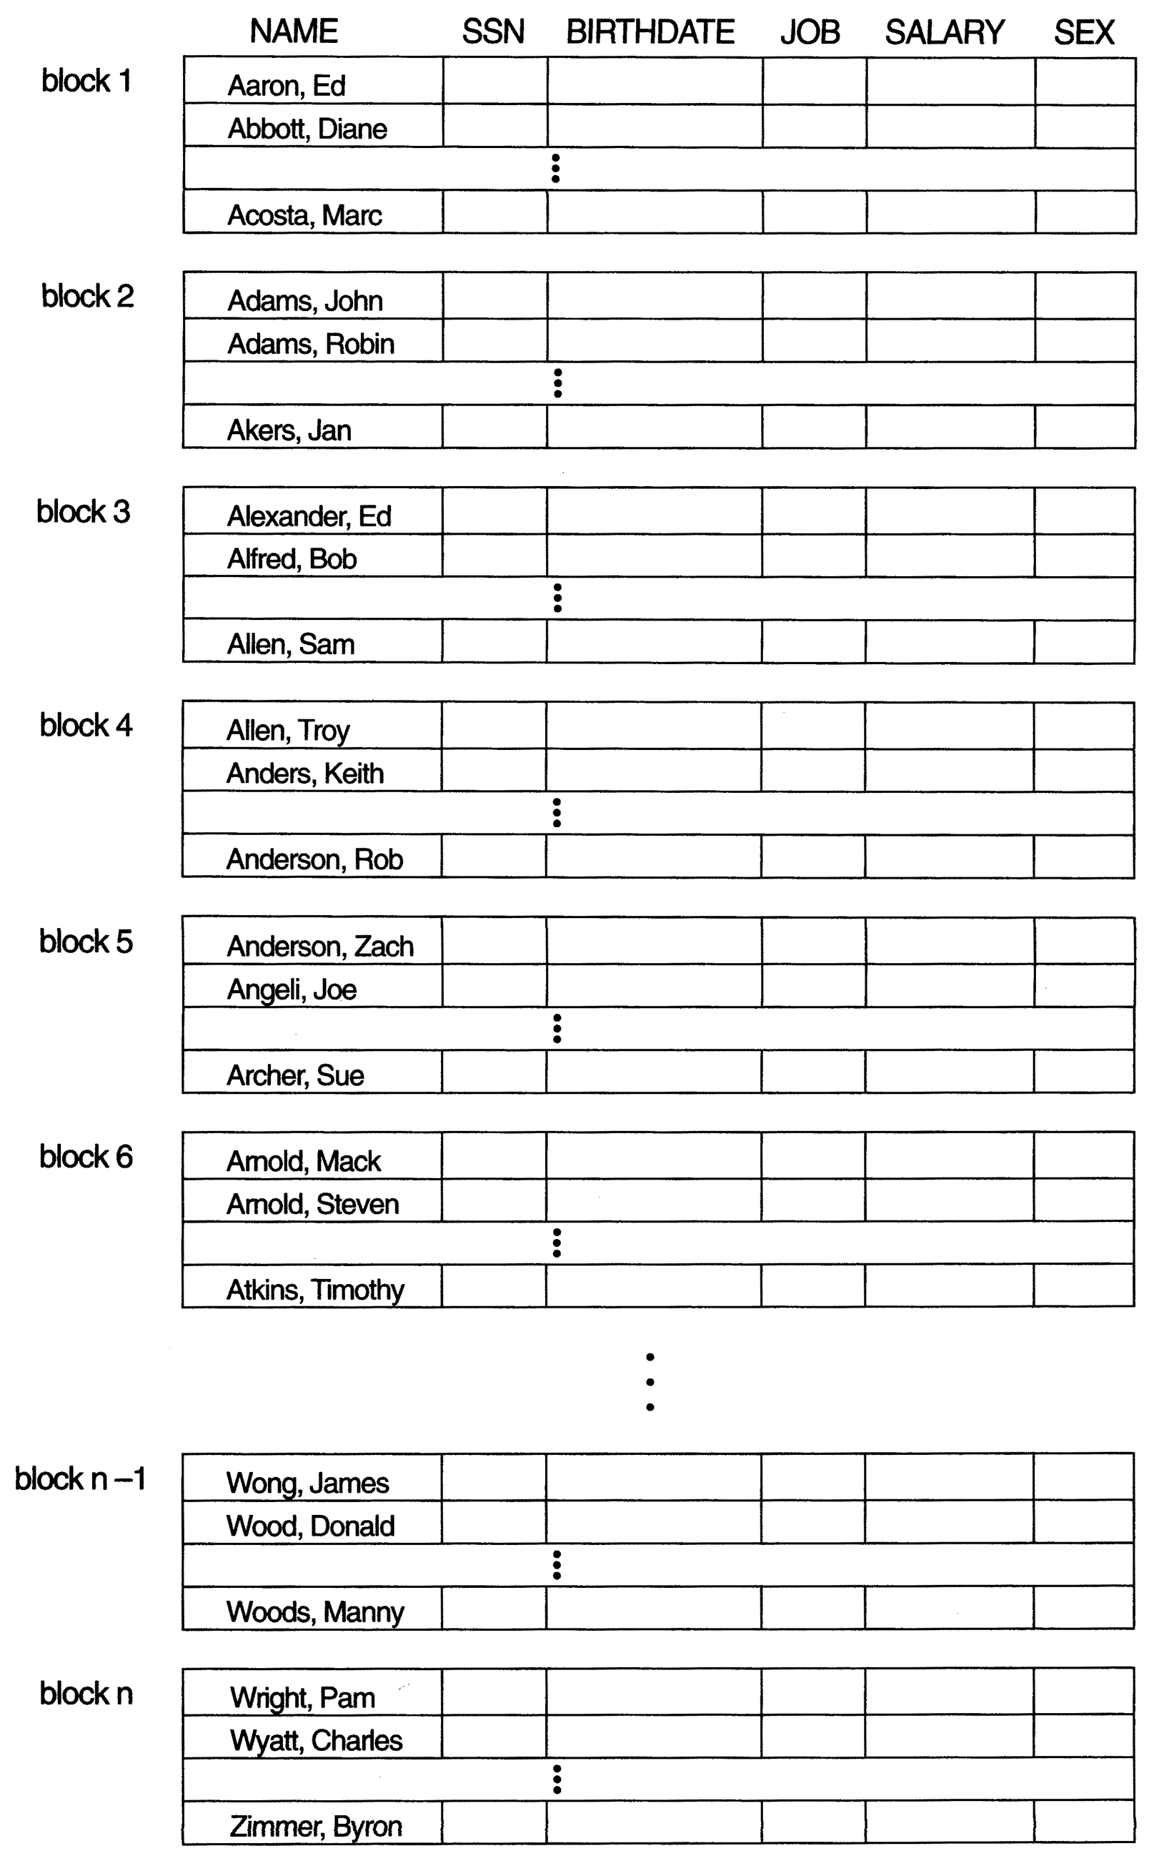
Ordered Files (cont.)

Slide 19
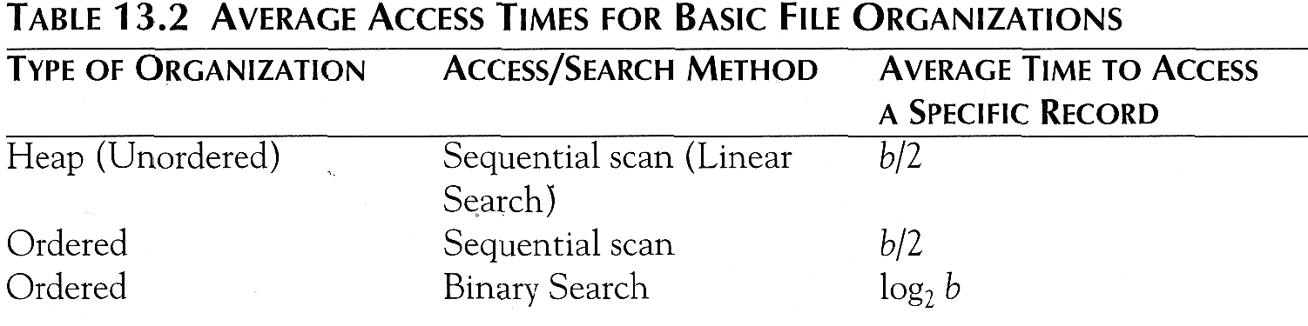
Average Access Times
The following table shows the average access time to access a specific record for a given type of file

Slide 20
Hashed Files
Hashing for disk files is called External Hashing
The file blocks are divided into M equal-sized buckets, numbered bucket₀, bucket₁, ..., bucket _{M-1}. Typically, a bucket corresponds to one (or a fixed number of) disk block.
One of the file fields is designated to be the hash key of the file.
The record with hash key value K is stored in bucket i, where i=h(K), and h is the hashing function.
Search is very efficient on the hash key.
Collisions occur when a new record hashes to a bucket that is already full. An overflow file is kept for storing such records. Overflow records that hash to each bucket can be linked together.

Slide 21
Hashed Files (cont.)
There are numerous methods for collision resolution, including the following:
Open addressing: Proceeding from the occupied position specified by the hash address, the program checks the subsequent positions in order until an unused (empty) position is found.
Chaining: For this method, various overflow locations are kept, usually by extending the array with a number of overflow positions. In addition, a pointer field is added to each record location. A collision is resolved by placing the new record in an unused overflow location and setting the pointer of the occupied hash address location to the address of that overflow location.
Multiple hashing: The program applies a second hash function if the first results in a collision. If another collision results, the program uses open addressing or applies a third hash function and then uses open addressing if necessary.

Slide 22
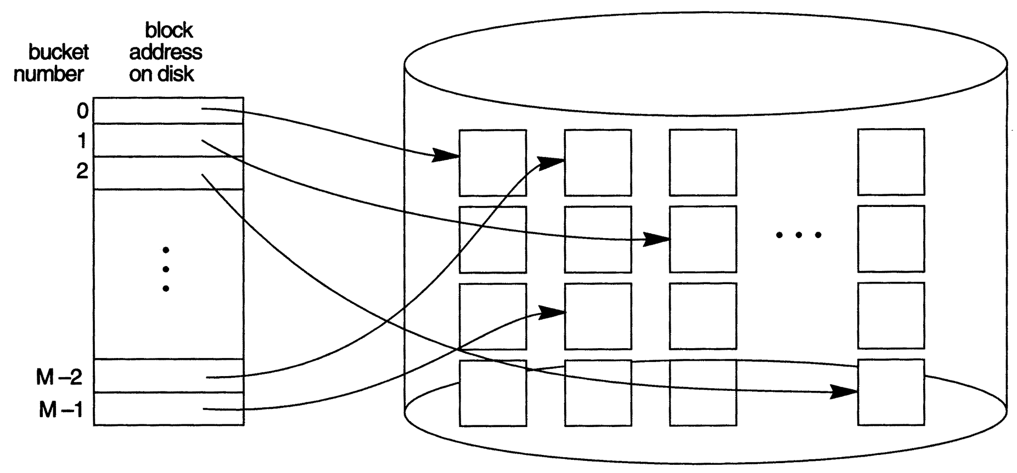
Hashed Files (cont.)

Slide 23
Hashed Files (cont.)
To reduce overflow records, a hash file is typically kept 70-80% full.
The hash function h should distribute the records uniformly among the buckets; otherwise, search time will be increased because many overflow records will exist.
Main disadvantages of static external hashing:
- Fixed number of buckets M is a problem if the number of records in the file grows or shrinks.
- Ordered access on the hash key is quite inefficient (requires sorting the records).

Slide 24
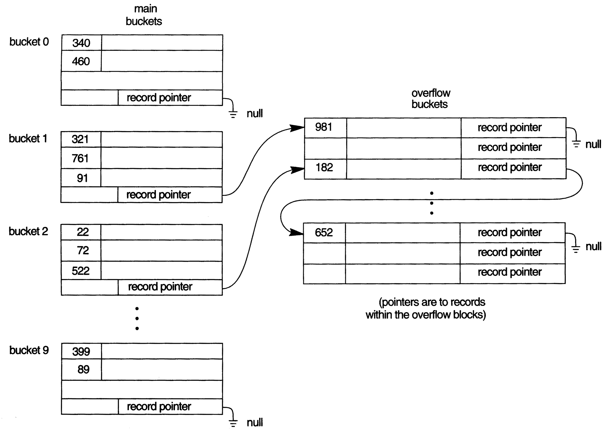
Hashed Files - Overflow handling

Slide 25
Dynamic And Extendible Hashed Files
Dynamic and Extendible Hashing Techniques
Hashing techniques are adapted to allow the dynamic growth and shrinking of the number of file records.
These techniques include the following: dynamic hashing , extendible hashing , and linear hashing .
Both dynamic and extendible hashing use the binary representation of the hash value h(K) in order to access a directory. In dynamic hashing the directory is a binary tree. In extendible hashing the directory is an array of size 2^{d} where d is called the global depth.

Slide 26
Dynamic And Extendible Hashing (cont.)
The directories can be stored on disk, and they expand or shrink dynamically. Directory entries point to the disk blocks that contain the stored records.
An insertion in a disk block that is full causes the block to split into two blocks and the records are redistributed among the two blocks. The directory is updated appropriately.
Dynamic and extendible hashing do not require an overflow area.
Linear hashing does require an overflow area but does not use a directory. Blocks are split in linear order as the file expands.

Slide 27
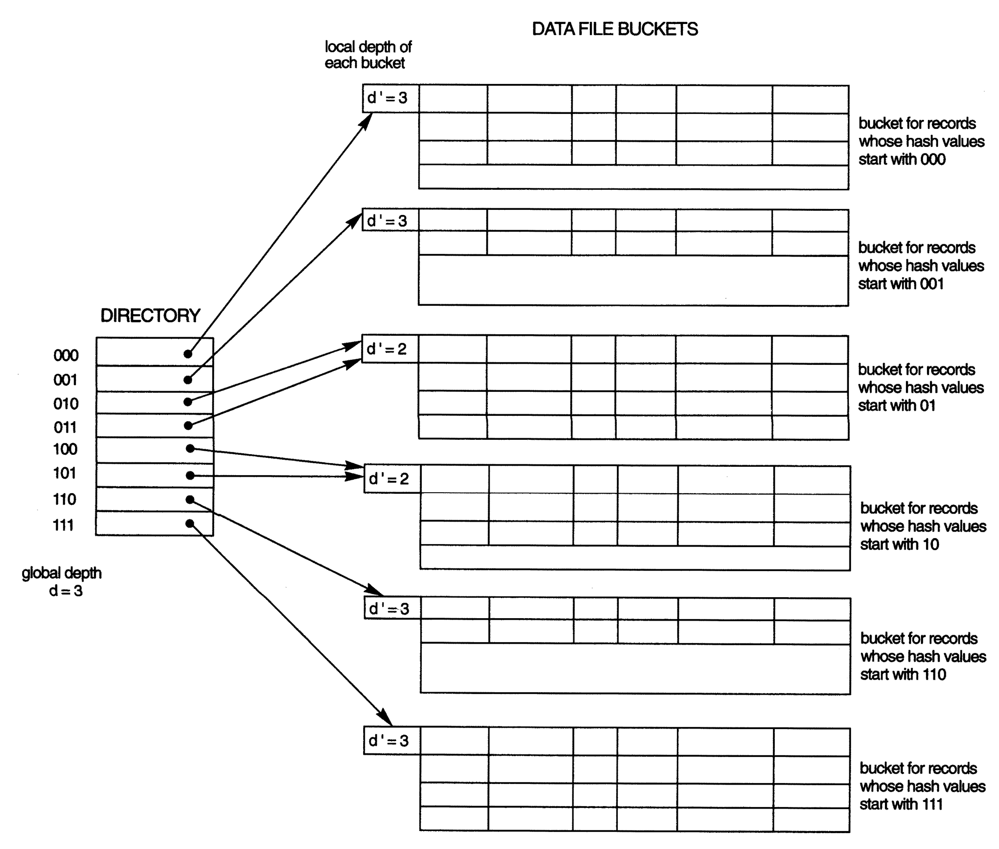
Extendible Hashing

Slide 28
Parallelizing Disk Access using RAID Technology.
Secondary storage technology must take steps to keep up in performance and reliability with processor technology.
A major advance in secondary storage technology is represented by the development of RAID, which originally stood for Redundant Arrays of Inexpensive Disks.
The main goal of RAID is to even out the widely different rates of performance improvement of disks against those in memory and microprocessors.

Slide 29
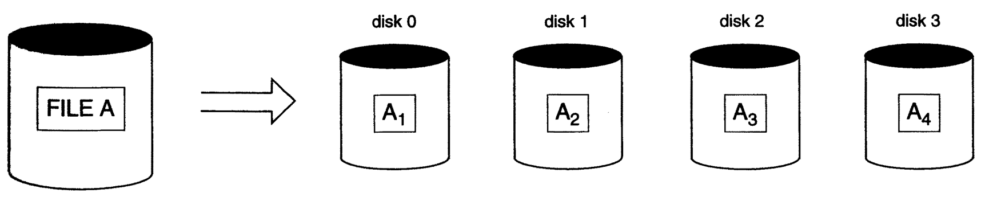
RAID Technology (cont.)
A natural solution is a large array of small independent disks acting as a single higher-performance logical disk. A concept called data striping is used, which utilizes parallelism to improve disk performance.
Data striping distributes data transparently over multiple disks to make them appear as a single large, fast disk.

Slide 30
RAID Technology (cont.)
Different raid organizations were defined based on different combinations of the two factors of granularity of data interleaving (striping) and pattern used to compute redundant information.
Raid level 0 has no redundant data and hence has the best write performance.
Raid level 1 uses mirrored disks.
Raid level 2 uses memory-style redundancy by using Hamming codes, which contain parity bits for distinct overlapping subsets of components. Level 2 includes both error detection and correction.
Raid level 3 uses a single parity disk relying on the disk controller to figure out which disk has failed.
Raid Levels 4 and 5 use block-level data striping, with level 5 distributing data and parity information across all disks.
Raid level 6 applies the so-called P + Q redundancy scheme using Reed-Soloman codes to protect against up to two disk failures by using just two redundant disks.

Slide 31
Use of RAID Technology (cont.)
Different raid organizations are being used under different situations
Raid level 1 (mirrored disks)is the easiest for rebuild of a disk from other disks
  It is used for critical applications like logs
Raid level 2 uses memory-style redundancy by using Hamming codes, which contain parity bits for distinct overlapping subsets of components. Level 2 includes both error detection and correction.
Raid level 3 ( single parity disks relying on the disk controller to figure out which disk has failed) and level 5 (block-level data striping) are preferred for Large volume storage, with level 3 giving higher transfer rates.
Most popular uses of the RAID technology currently are: Level 0 (with striping), Level 1 (with mirroring) and Level 5 with an extra drive for parity.
Design Decisions for RAID include – level of RAID, number of disks, choice of parity schemes, and grouping of disks for block-level striping.

Slide 32
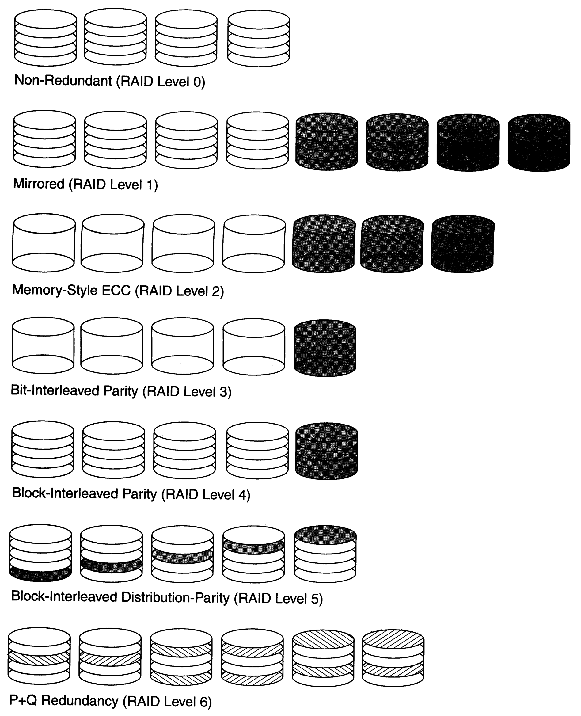
Use of RAID Technology (cont.)

Slide 33
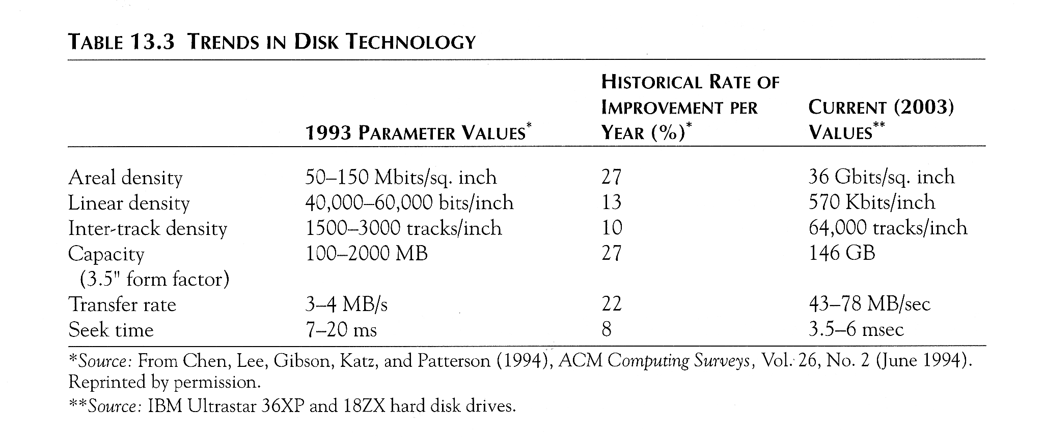
Trends in Disk Technology

Slide 34
Storage Area Networks
The demand for higher storage has risen considerably in recent times.
Organizations have a need to move from a static fixed data center oriented operation to a more flexible and dynamic infrastructure for information processing.
Thus they are moving to a concept of Storage Area Networks (SANs). In a SAN, online storage peripherals are configured as nodes on a high-speed network and can be attached and detached from servers in a very flexible manner.
This allows storage systems to be placed at longer distances from the servers and provide different performance and connectivity options.

Slide 35
Storage Area Networks (contd.)
Advantages of SANs are:
  Flexible many-to-many connectivity among servers and storage devices using fiber channel hubs and switches.
  Up to 10km separation between a server and a storage system using appropriate fiber optic cables.
  Better isolation capabilities allowing nondisruptive addition of new peripherals and servers.
SANs face the problem of combining storage options from multiple vendors and dealing with evolving standards of storage management software and hardware.

